Slide 1
Early Years Curriculum
Updated for September 2022

Slide 2
Intent
The curriculum at Dallam Primary is designed to provide a broad and balanced education that meets the needs of all of our children while delivering the learning and development requirements as stated in the new Early Years Framework September 2021. Through all 17 areas of the Early Years curriculum, it encourages effective communication, independence, curiosity, creativity and resilience to produce collaborators, innovators and leaders. Promoting physical development and mental well-being are key elements in supporting the development of the whole child and promoting a positive attitude to learning.
At Dallam Community Primary School we have a curriculum which is divided into three themed terms and overarching questions. They are organised to build on prior learning and to involve activities and experiences for all children set out in the educational programmes from the Statutory Framework for the Early Years Foundation Stage, DfE 2021. This approach enables children to make connections within and across subjects as they acquire the knowledge, understanding and skills they will need for the next stage in their learning and to make a positive contribution to and celebrate diversity within their community and in the wider world today and in the future.
Central to our curriculum are the recently updated Characteristics of Effective Teaching and Learning that underpin everything that we do:
Playing And Exploring
Realise that their actions have an effect on the world, so they want to keep repeating them.
Reach for and accept objects. Make choices and explore different resources and materials.
Plan and think ahead about how they will explore or play with objects.
Guide their own thinking and actions by talking to themselves while playing.
Make independent choices.
Do things independently that they have been previously taught.
Bring their own interests and fascinations into early years settings.
Active Learning
Participate in routines, such as going to their cot or mat when they want to sleep.
Begin to predict sequences because they know routines.
Show goal-directed behaviour.
Use a range of strategies to reach a goal they have set themselves.
Begin to correct their mistakes themselves.
Keep on trying when things are difficult.
Creating And Thinking Critically
Take part in simple pretend play.
Sort materials.
Review their progress as they try to achieve a goal. Check how well they are doing.
Solve real problems.
Use pretend play to think beyond the ‘here and now’ and to understand another perspective.
Know more, so feel confident about coming up with their own ideas.
Make more links between those ideas.
Concentrate on achieving something that’s important to them. They are increasingly able to control their attention and ignore distractions.

Slide 3
Long Term Plan
 | AUTUMN TERM |  | SPRING TERM |  | SUMMER TERM
Seedlings 2 year olds | Question: | What Can I Do By Myself? | Question: | Who Do I Share The World With? | Question: | How Can I Make My Mark?
 | Talk For Writing Books: | All About Me How Do You Feel? The Very Lazy Ladybird | Talk For Writing Books: | Dear Zoo Baby Goes To Market | Talk For Writing Books: | Elmer We’re Going On A Bear Hunt
 | Main themes: | Self-confidence, families, home life and self-care skills. | Main themes: | Animals and habitats | Main themes: | Natural art, sensory play and making marks using a variety of equipment / materials
Acorns 3 year olds | Question: | What Happens In My World? | Question: | Where Do Things Come From? | Question: | What Makes Me Unique?
 | Talk For Writing Books: | The Gruffalo Goldilocks and the 3 bears | Talk For Writing Books: | The Tiny Terrified Tiger (adaptation of Monkey Puzzle) The Chinese Zodiac Story Super Tato | Talk For Writing Books: | The Colour Monster And Tango Makes Three
 | Main themes: | Family, friends, people who help us | Main themes: | Celebrations in other cultures, Superheroes, vegetables and growing | Main themes: | Colour mixing, growing up, different families
Ash Class Reception | Question: | How Do We Remember Things From The Past? | Question: | How Has The Natural World Changed? | Question: | What Makes The World A Beautiful Place?
 | Talk For Writing Books: | The 3 Little Pigs The Little Green Witch Cave Baby | Talk For Writing Books: | No Place Like Home Handa’s Surprise | Talk For Writing Books: | The Hedgehog And Her Hoglet Bugs In A Blanket
 | Main themes: | My family and home, different families and cultures, people who help us, Dinosaurs, volcanoes, historical figures | Main themes: | Other countries, Africa, other cultures, animals – zoo trip | Main themes: | Growing, natural art, relationships, celebrating difference

Slide 4
Educational Programmes
There are seven areas of learning and development that shape educational programmes in early years settings. All areas of learning and development are important and inter-connected.
Three areas are particularly important for building a foundation for igniting children’s curiosity and enthusiasm for learning, forming relationships and thriving.
These are the prime areas:
• Communication And Language
• Physical Development
• Personal, Social And Emotional Development
Providers must also support children in four specific areas, through which the three prime areas are strengthened and applied.
The specific areas are:
• Literacy
• Mathematics
• Understanding The World
• Expressive Arts And Design
Educational programmes must involve activities and experiences for children, as set out under each of the areas of learning. The expectations for children’s development must ensure that cognitive development proceeds hand-in-hand with their social and personal development.

Slide 5
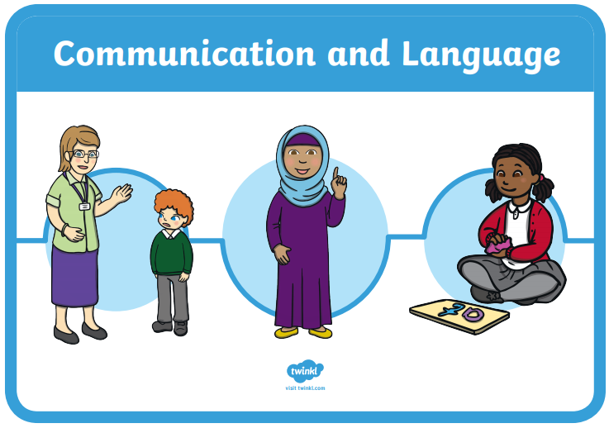
Communication and Language
The development of children’s spoken language underpins all seven areas of learning and development. Children’s back-and-forth interactions from an early age form the foundations for language and cognitive development.
The number and quality of the conversations they have with adults and peers throughout the day in a language-rich environment is crucial. By commenting on what children are interested in or doing, and echoing back what they say with new vocabulary added, practitioners will build children's language effectively.
Reading frequently to children, and engaging them actively in stories, non-fiction, rhymes and poems, and then providing them with extensive opportunities to use and embed new words in a range of contexts, will give children the opportunity to thrive.
Through conversation, story-telling and role play, where children share their ideas with support and modelling from their teacher, and sensitive questioning that invites them to elaborate, children become comfortable using a rich range of vocabulary and language structures.

Slide 6
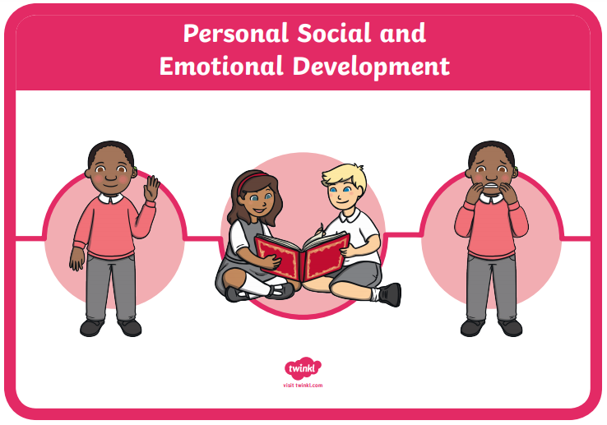
Personal, Social and Emotional Development
Children’s personal, social and emotional development (PSED) is crucial for children to lead healthy and happy lives, and is fundamental to their cognitive development.
Underpinning their personal development are the important attachments that shape their social world. Strong, warm and supportive relationships with adults enable children to learn how to understand their own feelings and those of others.
Children should be supported to manage emotions, develop a positive sense of self, set themselves simple goals, have confidence in their own abilities, to persist and wait for what they want and direct attention as EYFS reforms early adopter framework 9 necessary.
Through adult modelling and guidance, they will learn how to look after their bodies, including healthy eating, and manage personal needs independently. Through supported interaction with other children they learn how to make good friendships, co-operate and resolve conflicts peaceably. These attributes will provide a secure platform from which children can achieve at school and in later life.

Slide 7
Physical Development
Physical activity is vital in children’s all-round development, enabling them to pursue happy, healthy and active lives. Gross and fine motor experiences develop incrementally throughout early childhood, starting with sensory explorations and the development of a child’s strength, co-ordination and positional awareness through tummy time, crawling and play movement with both objects and adults.
By creating games and providing opportunities for play both indoors and outdoors, adults can support children to develop their core strength, stability, balance, spatial awareness, co-ordination and agility.
Gross motor skills provide the foundation for developing healthy bodies and social and emotional well-being.
Fine motor control and precision helps with hand-eye co-ordination which is later linked to early literacy. Repeated and varied opportunities to explore and play with small world activities, puzzles, arts and crafts and the practise of using small tools, with feedback and support from adults, allow children to develop proficiency, control and confidence.

Slide 8
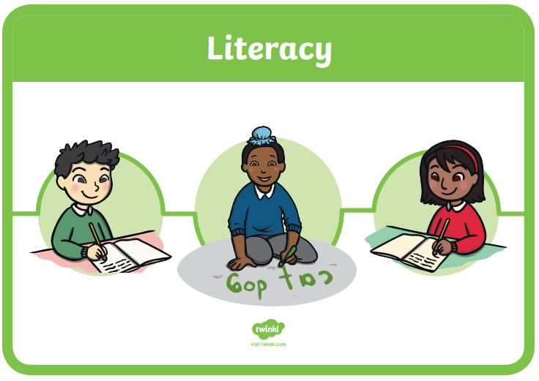
Literacy
It is crucial for children to develop a life-long love of reading. Reading consists of two dimensions: language comprehension and word reading.
Language comprehension (necessary for both reading and writing) starts from birth. It only develops when adults talk with children about the world around them and the books (stories and non-fiction) they read with them, and enjoy rhymes, poems and songs together. Skilled word reading, taught later, involves both the speedy working out of the pronunciation of unfamiliar printed words (decoding) and the speedy recognition of familiar printed words.
Writing involves transcription (spelling and handwriting) and composition (articulating ideas and structuring them in speech, before writing).

Slide 9
Mathematics
Developing a strong grounding in number is essential so that all children develop the necessary building blocks to excel mathematically.
Children should be able to count confidently, develop a deep understanding of the numbers to 10, the relationships between them and the patterns within those numbers. By providing frequent and varied opportunities to build and apply this understanding - such as using manipulatives, including small pebbles and tens frames for organising counting - children will develop a secure base of knowledge and vocabulary from which mastery of mathematics is built.
In addition, it is important that the curriculum includes rich opportunities for children to develop their spatial reasoning skills across all areas of mathematics including shape, space and measures.
It is important that children develop positive attitudes and interests in mathematics, look for patterns and relationships, spot connections, ‘have a go’, talk to adults and peers about what they notice and not be afraid to make mistakes.

Slide 10
Understanding the World
Understanding the world involves guiding children to make sense of their physical world and their community. The frequency and range of children’s personal experiences increases their knowledge and sense of the world around them – from visiting parks, libraries and museums to meeting important members of society such as police officers, nurses and firefighters.
In addition, listening to a broad selection of stories, non-fiction, rhymes and poems will foster their understanding of our culturally, socially, technologically and ecologically diverse world.
As well as building important knowledge, this extends their familiarity with words that support understanding across domains. Enriching and widening children’s vocabulary will support later reading comprehension.

Slide 11
Expressive Arts and Design
The development of children’s artistic and cultural awareness supports their imagination and creativity.
It is important that children have regular opportunities to engage with the arts, enabling them to explore and play with a wide range of media and materials.
The quality and variety of what children see, hear and participate in is crucial for developing their understanding, self-expression, vocabulary and ability to communicate through the arts.
The frequency, repetition and depth of their experiences are fundamental to their progress in interpreting and appreciating what they hear, respond to and observe.

